Slide 1
Sherlock Holmes
Vepuri Vinay Kumar

Slide 2
Contents
History
221B
Personality and skills

Slide 3
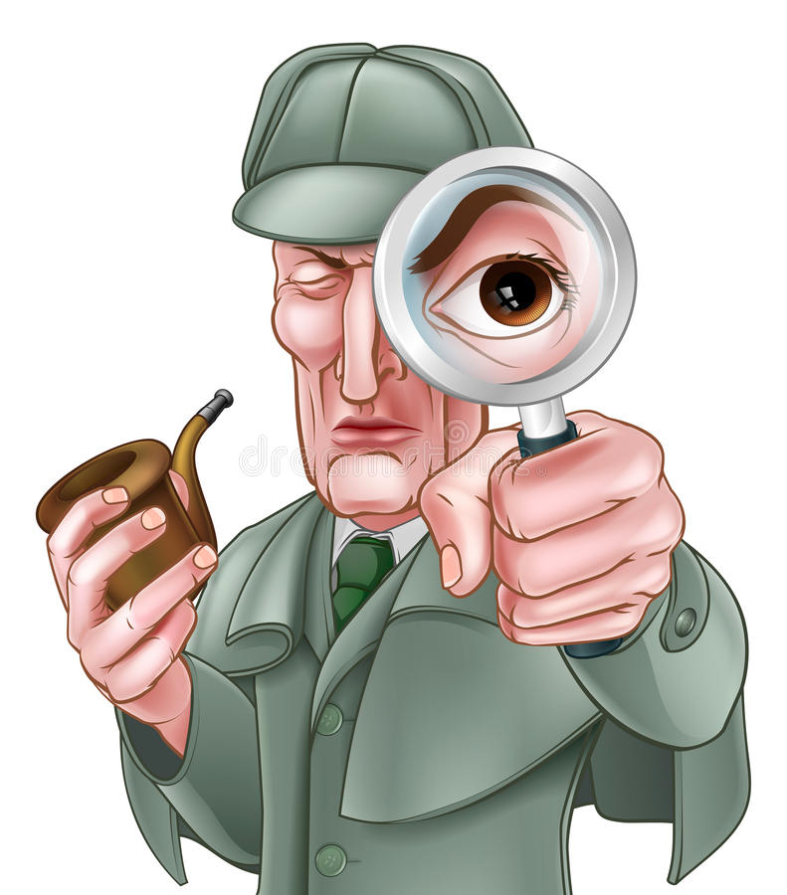
History
Sherlock Holmes is a fictional private detective created by British author Sir Arthur Conan Doyle.
Holmes is a character inspired by the real-life figure of Joseph Bell, a surgeon, and Sir Henry Littlejohn, a police surgeon and medical officer.

Slide 4
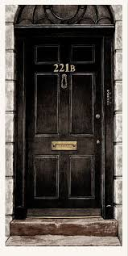
221B
Sherlock Holmes is a fictional private detective created by British author Sir Arthur Conan Doyle.
Holmes is a character inspired by the real-life figure of Joseph Bell, a surgeon, and Sir Henry Littlejohn, a police surgeon and medical officer.

Slide 5
Sub Topic
Sub Topic 1
  Sub Sub Topic 1.1
Sub Topic 2
  Sub Sub Topic 1.2

